Slide 1

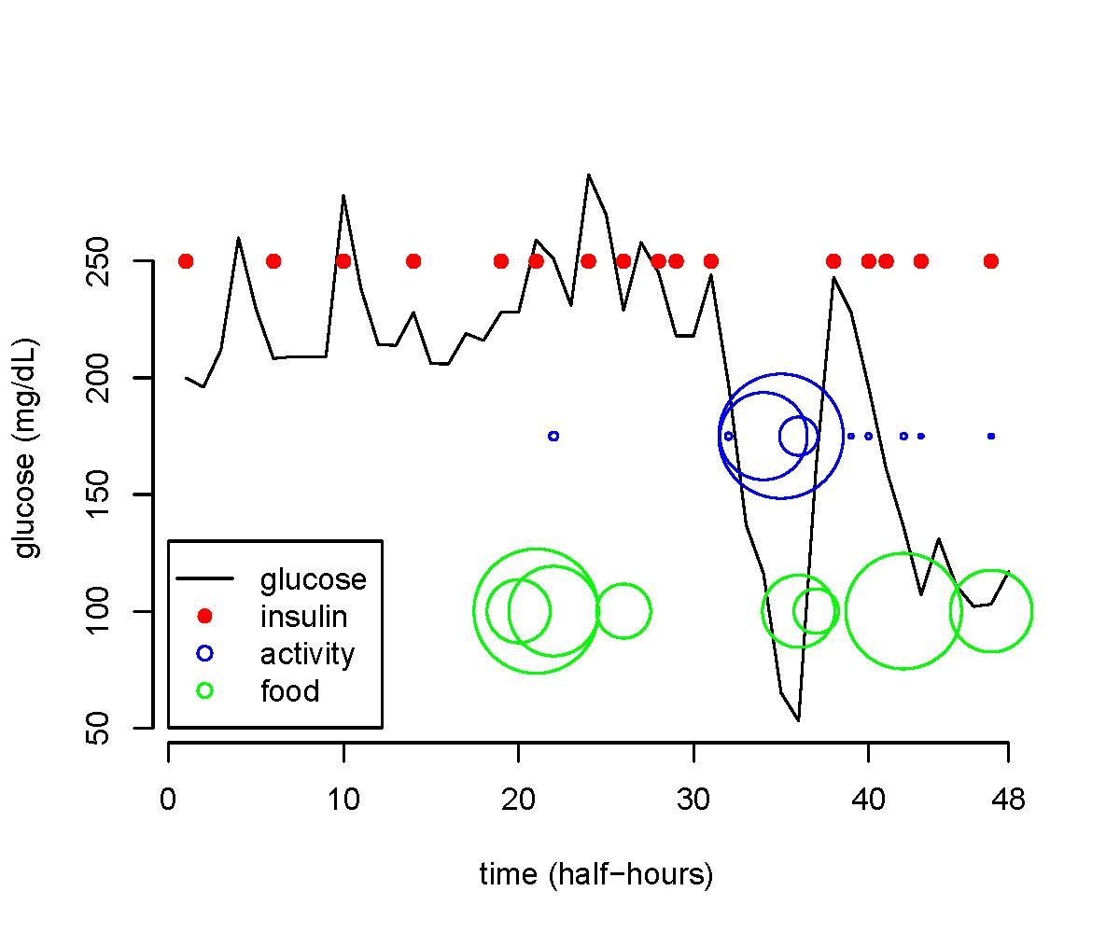
Recent Developments in Machine Learning
And Precision Medicine
With Implications in Clinical Research
Michael R. Kosorok, PhD
Time course plot of glucose, Insulin, physical activity, and food intake for a single patient (data from Maahs et al, 2012)
Example image
April 4, 2019

Slide 2
Outline
Overview of precision medicine
Sketch of machine learning
Recent developments on the interface
Example 1: T1D precision diet selection
Example 2: T1D safe exercise strategies
Potential in radiation oncology
Concluding thoughts and resources

Slide 3
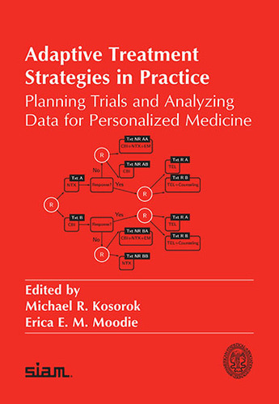
Precision Medicine and Precision Health
Precision Medicine
  Data-driven decision support for treating patients in the presence of heterogeneity (dynamic treatment regimes or DTRs)
  Treatment can include drug choice, administrative actions, dosing, timing, potentially modifiable risk factors, and/or other potentially beneficial actions to the patients
  Must be reproducible and generalizable (empirically and inferentially valid)
Precision Public Health
  Data-driven decision support for families, communities,
  clinics, social networks, and other entities
  Potential treatments can also be policies
Precision Health
  Union of precision medicine and precision health
  We always consider the consequences of our actions on the populations involved not just narrow subgroups or individuals

Slide 4

Operating Principles
Observable Constituents:
  Tailoring variables (X)
  Choice of treatments and/or potentially modifiable risk factors (A)
  Vector of outcomes or utilities (Y)
  Could be multiple (X,A,Y) triples over time for each patient
Dynamic Treatment Regime (DTR):
  Single decision: make a single recommendation for treatment
  Multiple decision: make a series of interdependent recommendations
  Continual monitoring: for diabetes, mHealth
Role of Heterogeneity in the data:
  Heterogeneity of patients is beneficial (essential) for good precision medicine analysis so that our treatment rules are broadly applicable
  Potential treatments can also be policies or risk factor modifications
  Need heterogeneity of treatment assignment (either
  naturally or by design) in the data so we can determine
  best treatment under a variety of situations

Slide 5
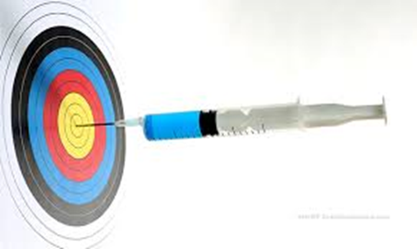
Overall Pipeline
Dynamic Treatment Regime d(X):
  This is rule which assigns treatment or action A to be recommended for a patient with characteristics X
Propensity Score P(A|X):
  This tells us whether there is a variety of A values across different X values
  We want this strictly between 0 and 1 to ensure we can decide between treatments at the individual level
Causal Methods:
  Foundational concepts underneath the approaches taken
  The potential outcome framework allows us to compare similar people (in terms of X) who experience different actions (in terms A) and how that affects outcome Y
  This leads to a decision support implementation
  d(X) with continuing iterative improvement

Slide 6
Overall Pipeline Details
Dynamic Treatment Regime:
  d(X) gives recommended A to maximize Y in future patients
  Regression: model Y as a function of X and A (Q(X,A)=E[Y|X,A] is the “value”), with interaction between X and A being most important
  Policy estimation: directly estimate d(X) without needing Q(X,A) (e.g., outcome weighted learning)
  Prediction versus prescriptive decision support:
    Suppose Y=f(X)+Ag(X)+e, where bigger Y is better and A={0 or 1}
    We only care about g(x), since rule d(X)={1 if g(X)>0, 0 otherwise} yields optimal
    A focus on prediction spends too much energy and focus on f(X) instead of g(X)
Propensity Score:
  P(A|X) is propensity score
  We estimate P(A|X) from data and make sure it is positive for all X
Causal Methods:
  Potential outcome validity (Y(0) and Y(1) are well behaved)
  No unmeasured confounders: Y(0) and Y(1) are independent given X
  Positivity assumption (P(A|X)>0 for all X)

Slide 7

Machine Learning
Methods of statistical analysis
Possible tasks:
  Unsupervised learning (e.g., clustering)
  Supervised learning (e.g., classification, regression, data-drive decision making)
  Partly supervised, and more
Statistical aspects:
  Will the method provide results
  reflecting the real world (reproducible)?
  Discovery vs. validation/confirmation

Slide 8

Machine Learning (cont.)
Additional tasks/tools:
  Reinforcement learning
    On-policy versus off-policy
  Deep learning
  Causal inference
Facilitate precision medicine:
  Discover dynamic treatment regimes (DTRs) to be described below
  Evaluate and validate discoveries (statistical)
  Implement in practice
AlphaGo AI becomes world champion

Slide 9
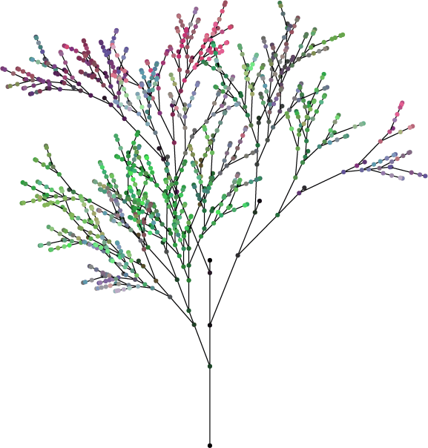
DTR Estimation
Single-decision setting:
  Regression and maximization
  Frequentist and Bayesian tools can be used (both good, but some non-Bayesian is better when data is high dimensional)
  Machine learning is very helpful
Multi-decision setting:
  Need reinforcement learning
  Q-learning is especially useful
  Q-learning involves a sequence of standard regressions: random forests are good here
  There is software for this (in R mostly)

Slide 10
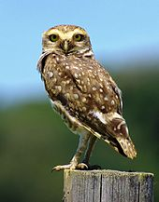
Recent Developments
Outcome weighted learning (OWL):
  Let patient tailoring features be X, treatment received A, and outcome of interest Y
  Standard regression approach: model Y using X and A as predictors (and include interactions)
  OWL: convert to classification problem of predicting A from X weighted by Y (avoids regression model)
Benefits of OWL:
  Converts problem to a classification task which can employ machine learning (such as SVM)
  Robust to regression model specification
  Performs very well in many situations
  Many extensions

Slide 11

Recent Developments, cont.
Extensions of OWL:
  Time-to-event outcomes with censoring
  Continuous treatment (such as dose)
  Multi-decision setting
    Finite horizon
    Infinite (indefinite) horizon (V-learning)
Other developments:
  Managing multiple competing outcomes
  Inverse reinforcement learning for precision medicine
  Adaptive study designs for precision medicine which integrate with machine learning (e.g. Thompson sampling)
$$∞$$

Slide 12

Recent Developments, cont.
Counterfactual Gaussian processes:
  Schulam P and Saria S (2017). Reliable decision support using counterfactual models. Neural Information Processing Systems (NIPS).
  Potential outcome-based prediction of treatment effects
Outcome Weighted Deep Learning:
  Liang M, Ye T, and Fu H (2018). Estimating individualized optimal combination therapies through outcome weighted deep learning algorithms. Statistics in Medicine 37:3869-3886.
  Powerfully flexible single-decision setting discovery
Off-Policy Deep Reinforcement Learning:
  Fujimoto S, Meger D, and Precup D (2018). Off-policy
  deep reinforcement learning without exploration.
  arXiv:1812.02900v2

Slide 13

Sequential Multiple Assignment Randomized Trials (SMARTs)
The key features of SMARTs are:
  Randomization at multiple decision times
  Choice of treatments or actions to randomize can depend on success of previously randomized treatments
  In medicine, these trials mimic (with foresight) what happens in the clinic
  Can be applied to policy questions
  Challenging to analyze: requires reinforcement learning techniques

Slide 14
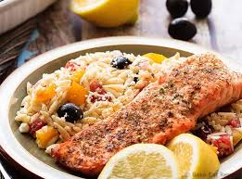
Example 1: T1D Precision Diet
Accelerating Solutions to Optimize Glycemic Control and Weight Management in Young Adults with Type 1 Diabetes: A SMART Study
  Three interventions:
    Diet 1: hypocaloric, moderate low fat, weight management based on the Look AHEAD study
    Diet 2: hypocaloric, low carbohydrate
    Diet 3: advice to select a healthy Mediterranean
    dietary pattern with no caloric restriction
  Outcomes: HbA1c and percent time in hypoglycemia, change in weight, tolerance of diet
  Response: favorable in all 4 outcomes
  Monitored every 3 months with response triggered diet reassignment with randomization if possible

Slide 15
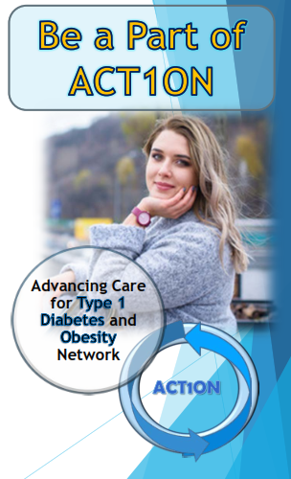
Participants
Two sites: UNC Chapel Hill and Stanford University
  19-30 years old
  T1D > 1 year
  HbA1c < 13.0%
  BMI 27-39
Notes:
New slide

Slide 16
Example 1, cont.
Month 0
Month 3
Month 6
Month 9
(final follow-up visit)
Diet 1
Diet 1
Diet 1
Diet 2
Diet 2
*
*
Diet 3
Diet 3
*
Diet 2
Diet 2
Diet 2
Diet 1
Diet 3
*
Diet 3
Diet 3
Diet 3
Diet 3
Diet 2
Diet 1
*
Legend
SMART Design Schematic for pilot study for discovery of precision diet selection for T1D patients
Diet 2
*
Randomization
Respond
Fail
Fail + Randomization
Bracketed groups
follows same
pattern as above
group of three
after permutation
*
Notes:
I changed Diet 2 to blue

Slide 17

Example 1, cont.
Currently recruiting patients (80 patients target)
Analyses:
  Standard comparison of diets at 3 months
  Estimation of optimal non-tailored treatment regime
  Estimation of tailored treatment regime (Q-learning to obtain precision medicine)
  Sample size calculation for fully powered SMART
Next step: fully powered SMART study
Future goal: continually learning and improving precision health care using machine learning integrated study design

Slide 18
Example 2: T1D and Safe Exercise
Goal: precision medicine for minute-by-minute control of blood glucose level and overall control of weight gain
Framework: data-driven decision science at multiple time scales using new hybrid SMART designs, mHealth, micro-randomization, system dynamics, and statistical control theory
Time course plot of glucose, insulin, physical activity, and food intake for a single pediatric patient (data from Maahs et al, 2012)
Notes:
I added pediatric* patient (CCAT data is young teens)

Slide 19
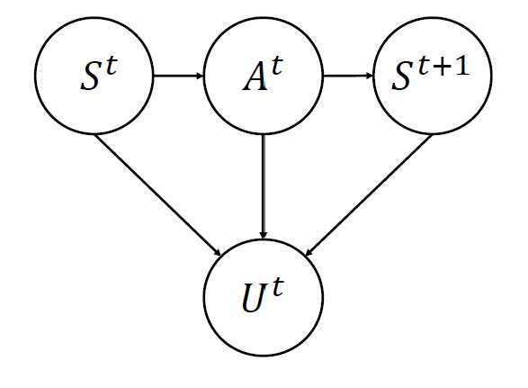
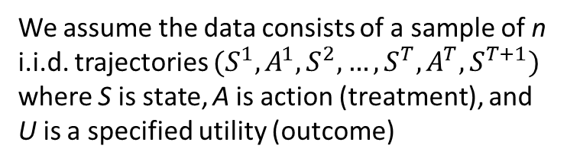
Example 2, cont.
We use a Markov decision process mathematical and statistical framework
We measure the state of the patient and actions which have been taken
V-learning is a new kind of reinforcement learning which incorporates outcome weighted learning
We assume the data consists of a sample of n i.i.d. trajectories $(S^{1},A^{1},S^{2},…,S^{T},A^{T},S^{T+1})$ where S is state, A is action (treatment), and U is a specified utility (outcome)
Graphical depiction of a Markov decision process indexed by discrete time points
Notes:
I added pediatric* patient (CCAT data is young teens)

Slide 20
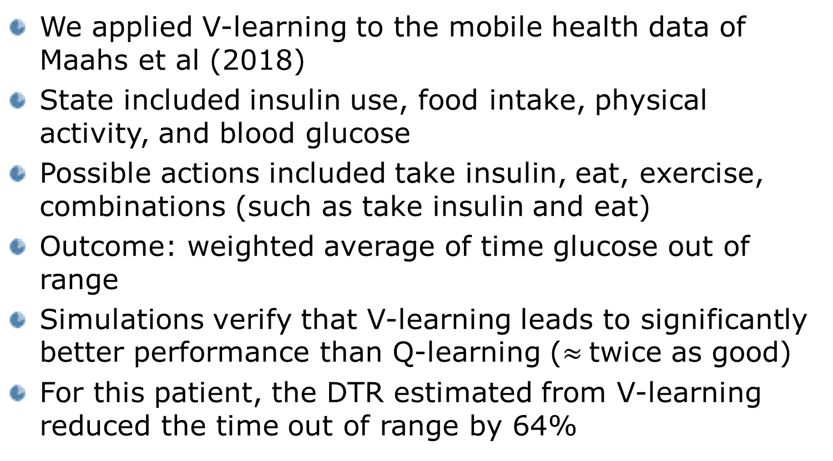
Results From V-Learning
We applied V-learning to the mobile health data of Maahs et al (2018)
State included insulin use, food intake, physical activity, and blood glucose
Possible actions included take insulin, eat, exercise, combinations (such as take insulin and eat)
Outcome: weighted average of time glucose out of range
Simulations verify that V-learning leads to significantly better performance than Q-learning ($≈$twice as good)
For this patient, the DTR estimated from V-learning reduced the time out of range by 64%
Notes:
More detail on how we think Hedra will work

Slide 21
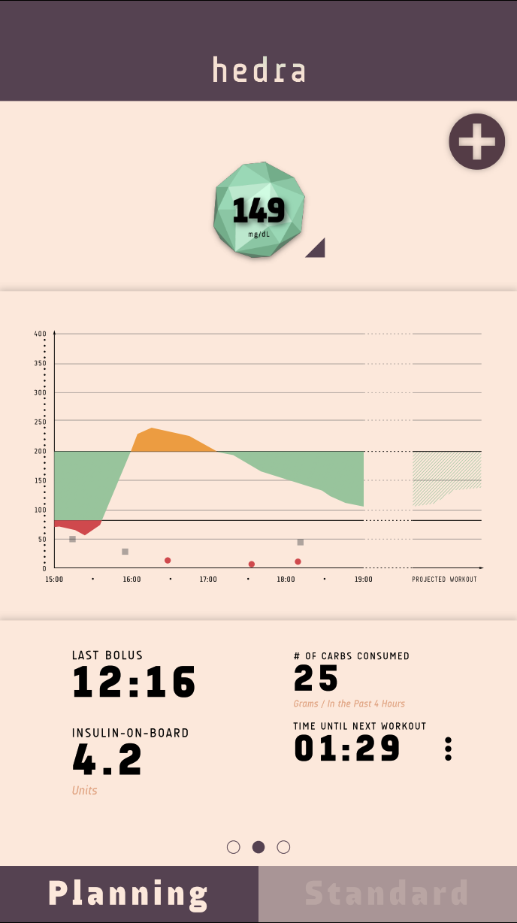
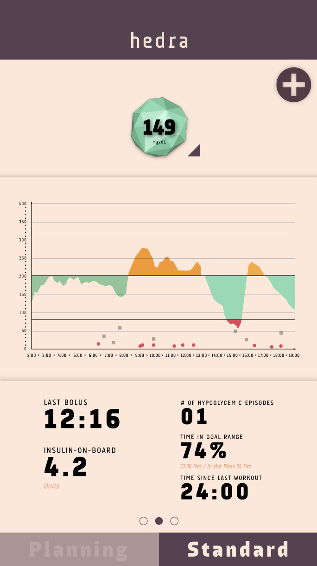
Two Modes- planning and standard

Slide 22
Potential In Radiation Oncology
Using imaging data for tailoring dose, etc.
  Prediction versus prescription
  Incorporating deep learning and GP
Using SMART designs and other precision medicine based randomized designs
Randomized versus observational studies
  Randomized designs offer orders of magnitude more information per data unit than observational studies
Heterogeneity in observational studies
  To be effective, we need strong heterogeneity of patients and treatment

Slide 23

Concluding Thoughts
There are many useful new methods in machine learning for precision medicine discovery
SMART study designs are powerful for discovery of precision medicine tools for clinical decision support
Off-policy reinforcement learning is a powerful kind of machine learning which can estimate dynamic treatment regimes from both observational and randomized study designs
Statistical inference principals are key to reproducibility
Although we have made much progress and can apply these method in practice, much work remains
Some resources are on the next slide

Slide 24
Some Resources
The PennState Methodology Center:
  https://www.methodology.psu.edu/
  Contains many resources and examples of SMART designs
DynTxRegime: A comprehensive package for analysis of dynamic treatment regimes (in R)
  https://www2.cscc.unc.edu/impact7/DynTxRegime
  Includes an interactive tutorial
Kosorok and Moodie (2016, SIAM). Adaptive Treatment Strategies in Practice: Planning Trials and Analyzing Data for Personalized Medicine
  http://bookstore.siam.org/sa21/
The Innovative Methods Program (IMPACT):
  https://www2.cscc.unc.edu/impact7/ (P01 CA142538)
  Collaborative resource: Drs. Kosorok, Davidian, Owzar

Slide 25
Thank You

